Slide 1
Chapter 6
Bandwidth Utilization:
Multiplexing and Spreading

Slide 2
Multiplexing & Spreading
Bandwidth utilization is the wise use of available bandwidth to achieve specific goals.
Efficiency can be achieved by multiplexing; i.e., sharing of the bandwidth between multiple users.
Privacy and anti-jamming can be achieved by spreading

Slide 3
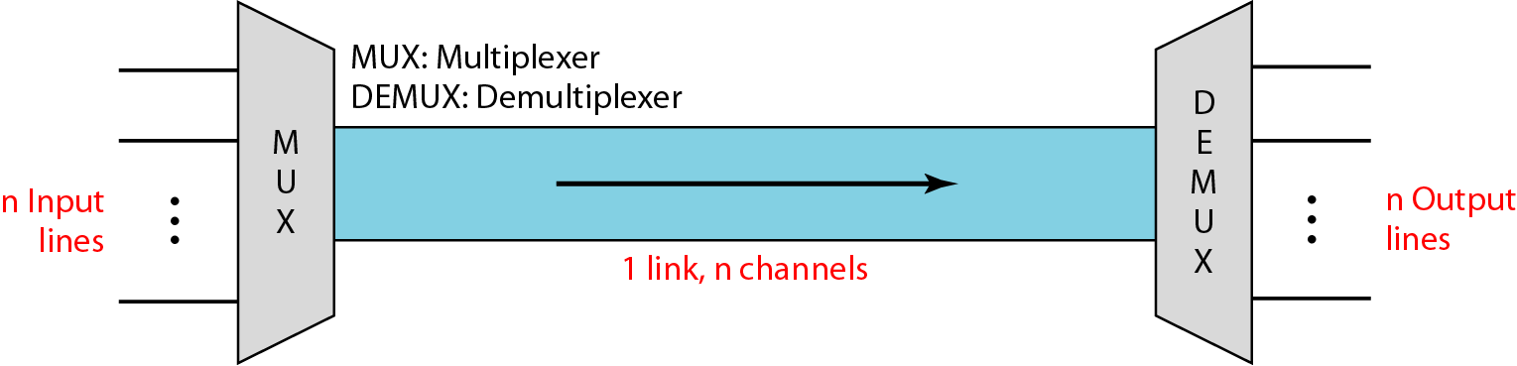
Multiplexing
Whenever the bandwidth of a medium linking two devices is greater than the bandwidth needs of the devices, the link can be shared. Multiplexing is the set of techniques that allows the (simultaneous) transmission of multiple signals across a single data link.

Slide 4
Multiplexing(cntd..)
In multiplexed system n lines share the bandwidth of same link
Here, a link refer to the physical path
Channel refer to the portion of link that carries a transmission between given pair of lines
One link may have many(n) channels

Slide 5
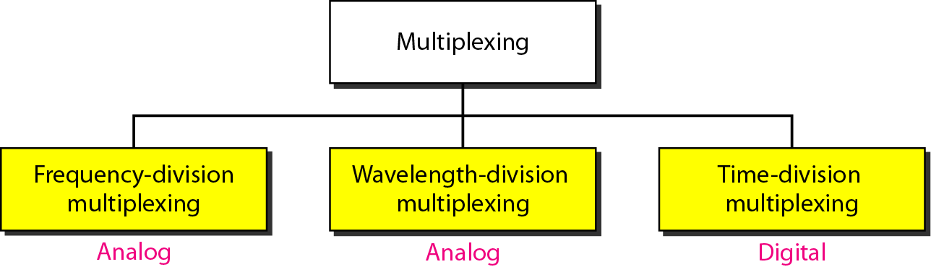
Categories of Multiplexing

Slide 6
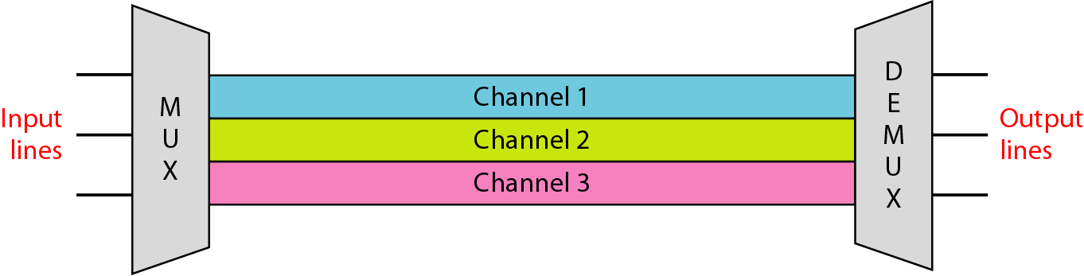
Frequency Division Multiplexing
FDM can be applied when bandwidth of link is greater than the combined bandwidth of signals to be transmitted

Slide 7
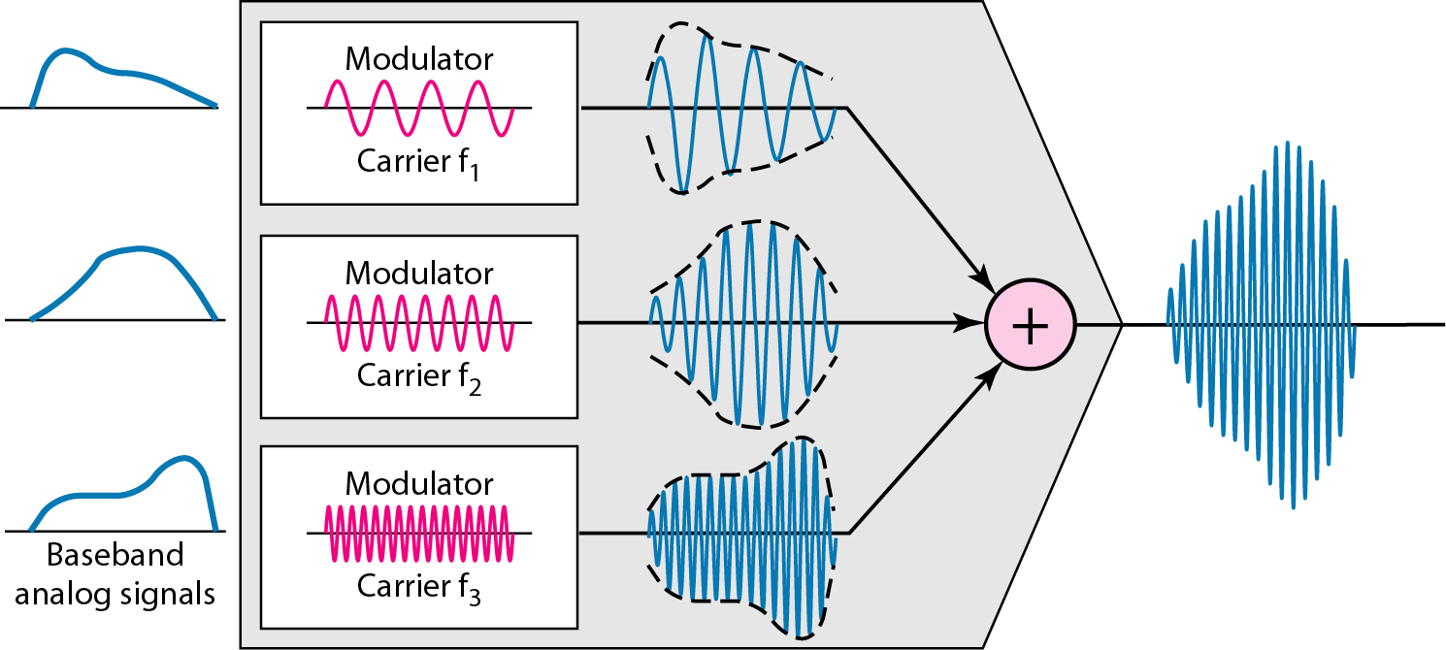
Multiplexing Process

Slide 8
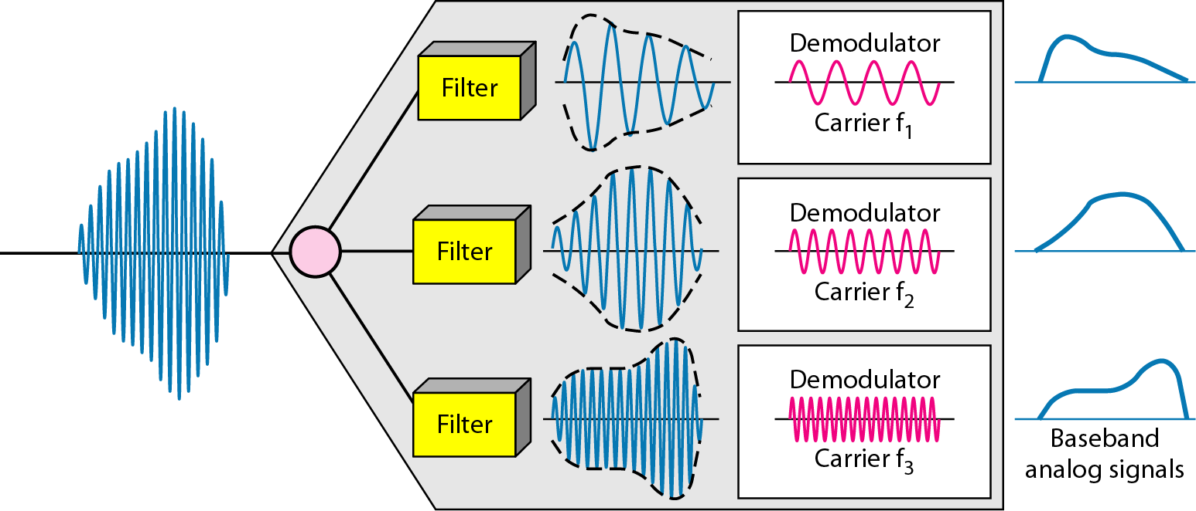
Demultiplexing Process
Demultiplexing uses series of filters to decompose multiplexed signal into its component signals
These individual signals then passes through demodulator that separates them from their carrier and passes to the output line

Slide 9
Example : 1
Assume that a voice channel occupies a bandwidth of 4 kHz. We need to combine three voice channels into a link with a bandwidth of 12 kHz, from 20 to 32 kHz. Show the configuration, using the frequency domain. Assume there are no guard bands.
Solution: We shift (modulate) each of the three voice channels to a different bandwidth, as shown in Figure, We use the 20 to 24 kHz bandwidth for the first channel, the 24 to 28 kHz bandwidth for the second channel, and the 28 to 32 kHz bandwidth for the third one. Then we combine them as shown in Figure.

Slide 10
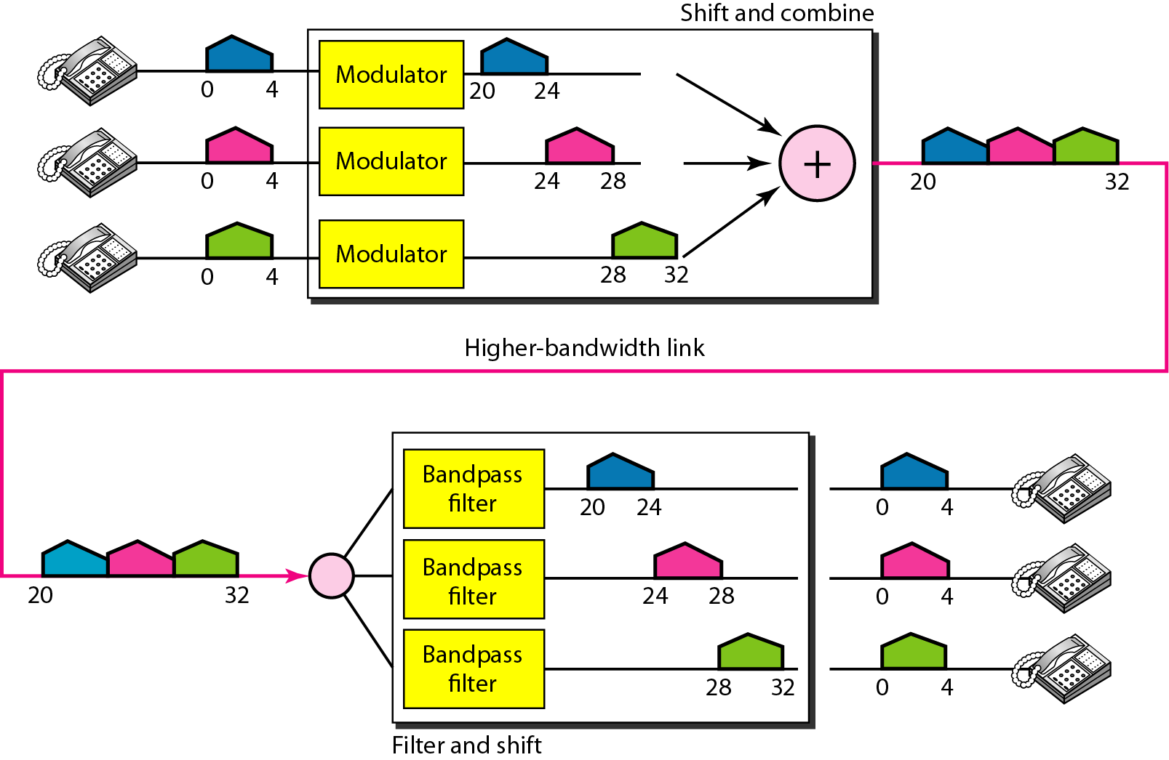
Solution: 1

Slide 11
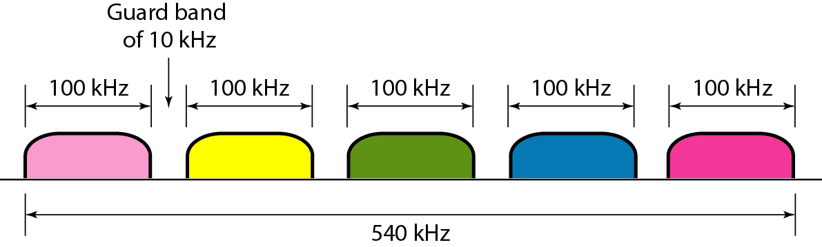
Example : 2
Five channels, each with a 100-kHz bandwidth, are to be multiplexed together. What is the minimum bandwidth of the link if there is a need for a guard band of 10 kHz between the channels to prevent interference?
Solution: For five channels, we need at least four guard bands. This means that the required bandwidth is at least
5 × 100 + 4 × 10 = 540 kHz, as shown in Figure

Slide 12
Applications
AM Broadcasting: In AM, range of band is 530 to 1700 kHz & every AM station needs 10 kHz of bandwidth. Each station uses different carrier frequency
FM Broadcasting: FM has wider band of 88 to 108 MHz & every FM station needs 200 kHz of bandwidth
TV Broadcasting: Each TV channel has its own bandwidth of 6 MHz

Slide 13
Applications (cntd..)
First generation cellular phones: each user is assigned two 30 kHz channels, one for sending voice and other for receiving
Voice signal has bandwidth around 3 kHz, is modulated by using FM. FM signal has a bandwidth 10 times that of the modulating signal, which means that each channel has 30 kHz of bandwidth.
So, each user is given by the base station, a 60 kHz bandwidth in range available at the time of the call.

Slide 14
Example 3
The Advanced Mobile Phone System (AMPS) uses two bands. The first band of 824 to 849 MHz is used for sending, and 869 to 894 MHz is used for receiving. Each user has a bandwidth of 30 kHz in each direction. How many people can use their cellular phones simultaneously?
Solution: Each band is 25 MHz. If we divide 25 MHz by 30 kHz, we get 833.33. In reality, the band is divided into 832 channels. of these, 42 channels are used for control, which means only 790 channels are available for cellular phone users.

Slide 15
Wavelength Division Multiplexing
Wavelength-division multiplexing (WDM) is designed to use the high-data-rate capability of fiber-optic cable
The optical fiber data rate is higher than the data rate of metallic transmission cable, but using a fiber-optic cable for a single line wastes the available bandwidth.
Multiplexing allows us to combine several lines into one.
WDM is conceptually the same as FDM, except that the multiplexing and demultiplexing involve optical signals transmitted through fiber-optic channels.

Slide 16
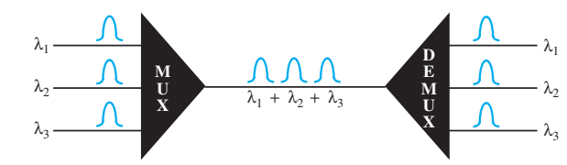
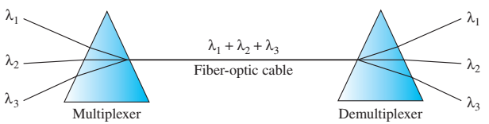
Wavelength Division Multiplexing
WDM combines multiple light sources into one single light at the multiplexer and does the reverse at the demultiplexer. It can easily be done by a prism.
One application of WDM is the SONET network, in which multiple optical Fiber lines are multiplexed and demultiplexed

Slide 17
Time Division Multiplexing
TDM is a digital multiplexing technique for combining several low-rate digital
channels into one high-rate one
Instead of sharing a portion of the bandwidth as in FDM, TDM allows several connections to share the high bandwidth of a link
TDM is a digital multiplexing technique where digital data from different sources are combined into one timeshared link

Slide 18
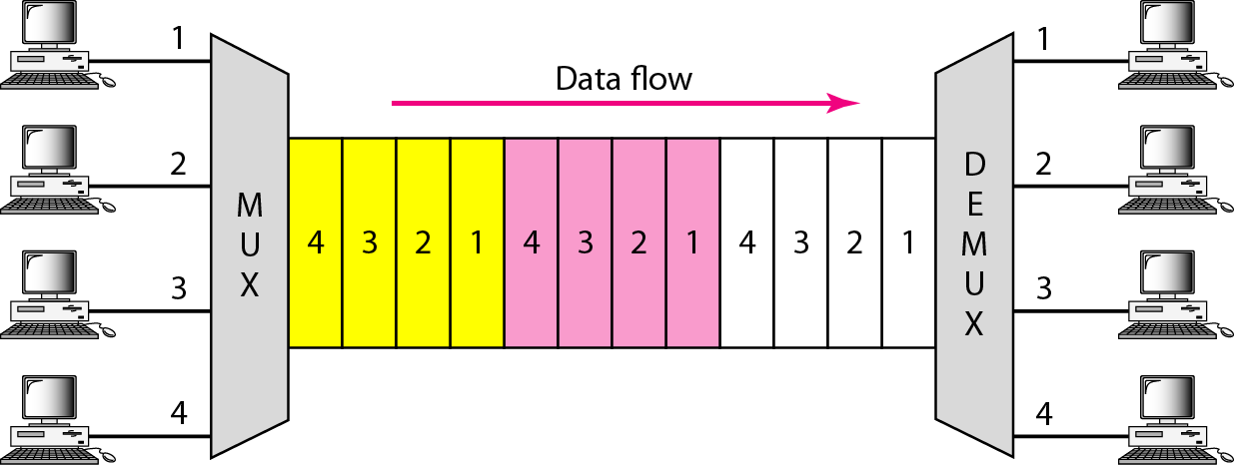
Time Division Multiplexing(cntd..)
There are two types : Synchronous TDM
Statistical TDM

Slide 19
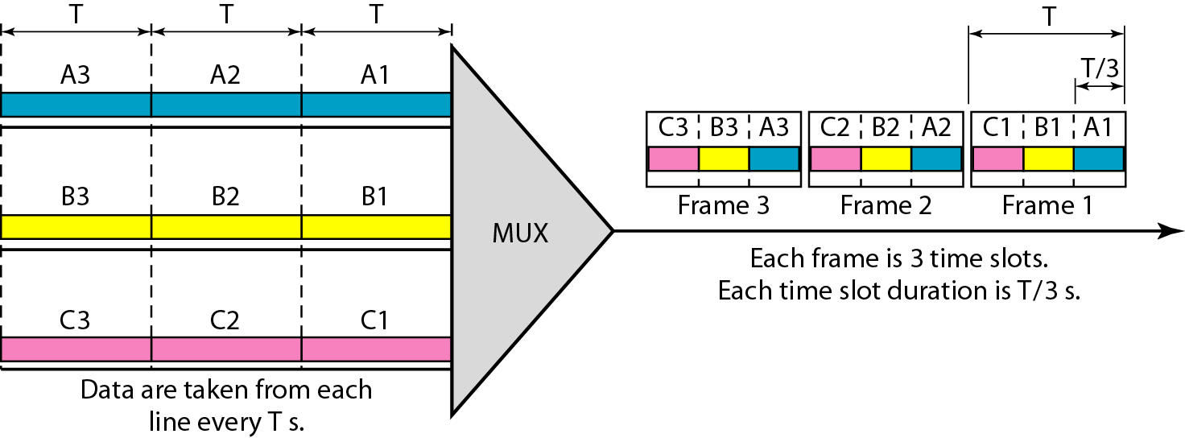
Synchronous TDM
In synchronous TDM, the data rate of the link is n times faster, and the unit duration is n times shorter
Time slots are grouped into frames. A frame consists of one complete cycle of time slots, with one slot dedicated to each sending device.

Slide 20
Example
The data rate for each input connection is 1 kbps. If 1 bit at a time is multiplexed (a unit is 1 bit), what is the duration of
  each input slot,
  each output slot, and
  each frame?
The data rate of each input connection is 1 kbps. This means that the bit duration is 1/1000 s or 1 ms. The duration of the input time slot is 1 ms (same as bit duration).
The duration of each output time slot is one-third of the input time slot. This means that the duration of the output time slot is 1/3 ms.
Each frame carries three output time slots. So the duration of a frame is 3 × 1/3 ms, or 1 ms. The duration of a frame is the same as the duration of an input unit.

Slide 21
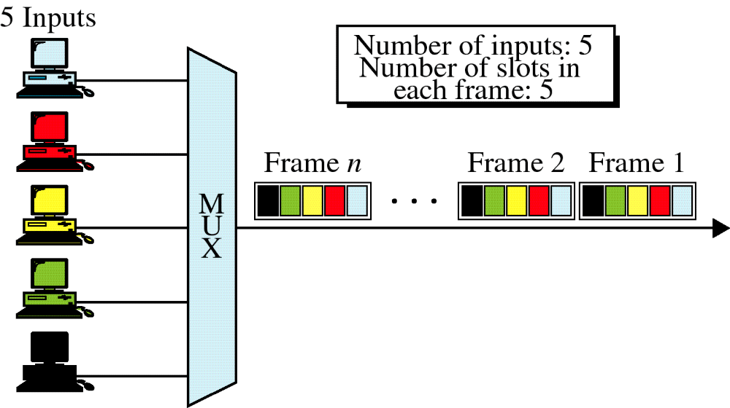
Synchronous TDM

Slide 22
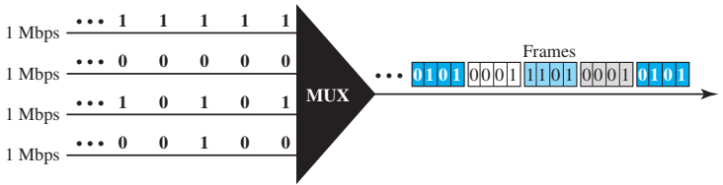
Example
The unit of data is 1 bit. Find (1) the input bit duration, (2) the output bit duration, (3) the output bit rate, and (4) the output frame rate.
The input bit duration is the inverse of the bit rate: 1/1 Mbps = 1 μs
The output bit duration is one-fourth of the input bit duration, or 1/4 μs.
The output bit rate is the inverse of the output bit duration, or 1/4 μs, or 4 Mbps. This can also be deduced from the fact that the output rate is 4 times as fast as any input rate; so the output rate = 4 × 1 Mbps = 4 Mbps.
The frame rate is always the same as any input rate. So the frame rate is 1,000,000 frames per second

Slide 23
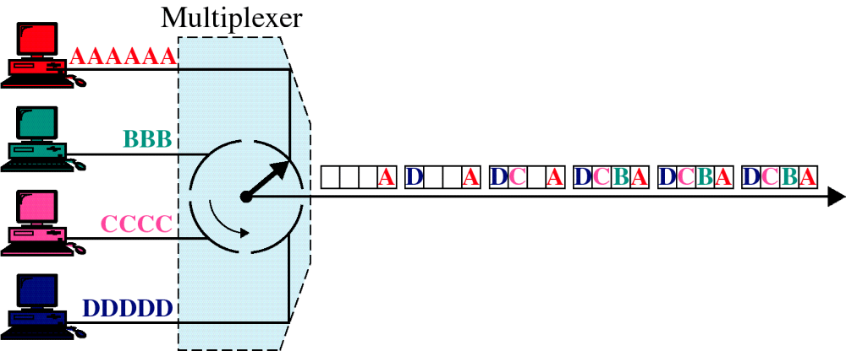
TDM, Multiplexing

Slide 24
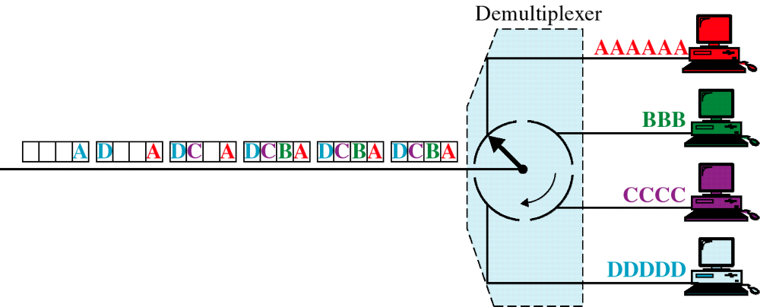
TDM, Demultiplexing

Slide 25
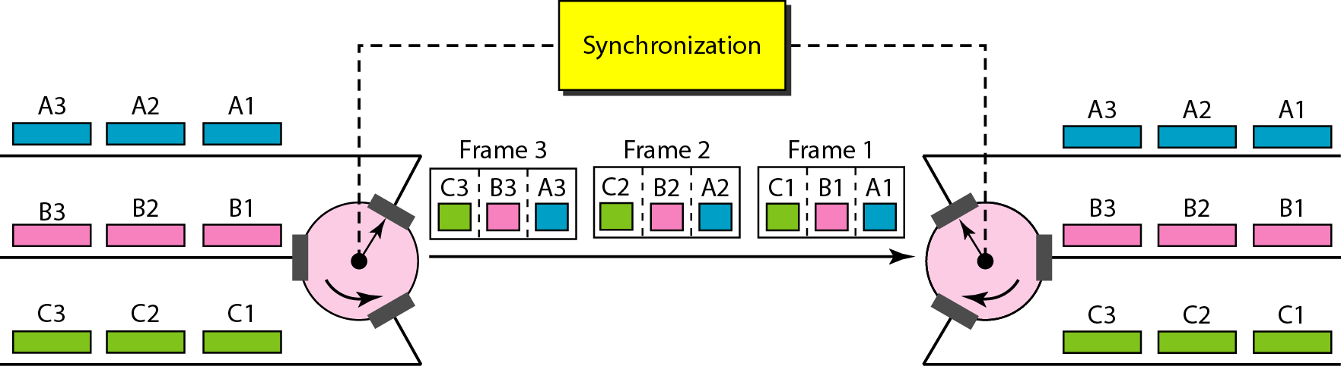
Interleaving
TDM can be visualized as two fast-rotating switches, one on the multiplexing side and the other on the demultiplexing side. The switches are synchronized and rotate at the same speed, but in opposite directions.
The process of taking a group of bits from each input line for multiplexing is called interleaving.
We interleave bits from each input onto one output.

Slide 26
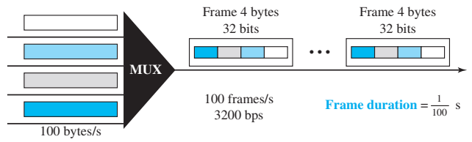
Example
Four channels are multiplexed using TDM. If each channel sends 100 bytes/s and we multiplex 1 byte per channel, show the frame traveling on the link, the size of the frame, the duration of a frame, the frame rate, and the bit rate for the link.

Slide 27
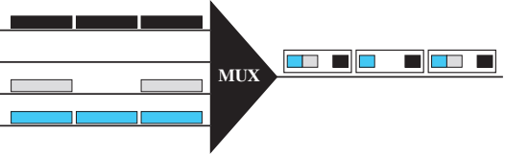
Empty Slots
If a source does not have data to send, the corresponding slot in the output frame is empty.
Synchronous TDM is not as efficient as it could be
Statistical TDM can improve efficiency by removing the empty slots from the frame.

Slide 28
Data Rate Management
Problem with TDM: handling of disparity in the input data rates.
If data rate are not same following three strategies of their combinations can be used:
  Multilevel multiplexing
  Multiple-slot allocation
  Pulse stuffing

Slide 29
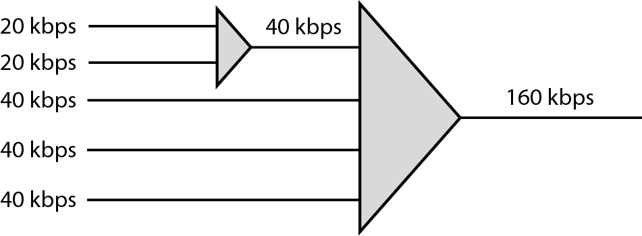
Multilevel Multiplexing
This technique is used when the data rate of an input line is a multiple of others

Slide 30
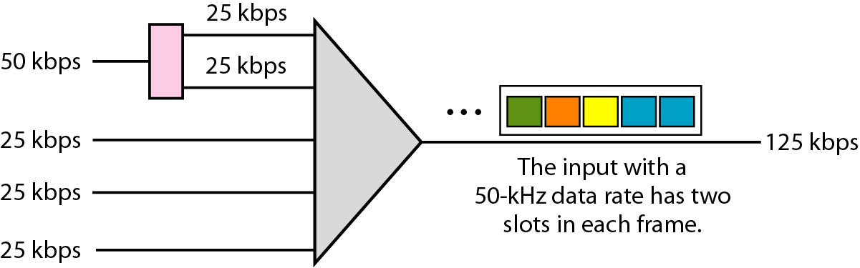
Multiple-slot Multiplexing
Sometimes it is more efficient to allot more than one slot in a frame to a single input line
We might have an input line that has a data rate that is a multiple of another input

Slide 31
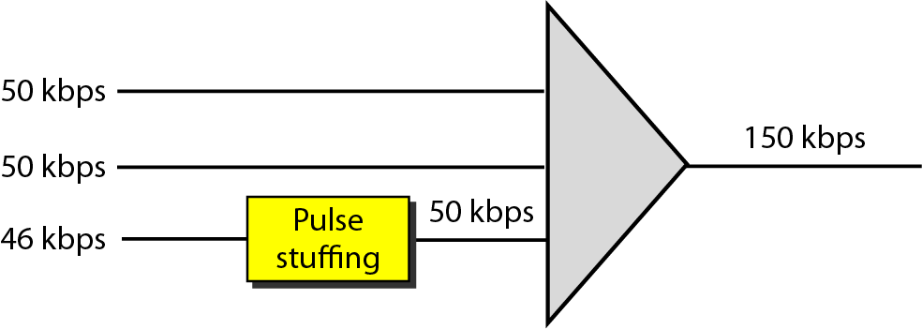
Pulse Stuffing
Sometimes bit rates of sources are not multiple integers of each other
Solution is to make the highest input data rate the dominant data rate and then add dummy bits to the input lines with lower rates

Slide 32
Frame Synchronization
TDM is complex than FDM as Synchronization between the multiplexer and demultiplexer is mandatory
If the multiplexer and the demultiplexer are not synchronized, a bit belonging to one channel may be received by the wrong channel.
For this reason, one or more synchronization bits are usually added to the beginning of each frame.
These bits, called framing bits, follow a pattern; frame to frame, that allows the demultiplexer to synchronize with the incoming stream so that it can separate the time slots accurately

Slide 33
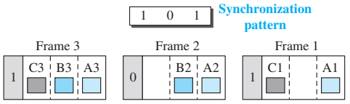
Frame Synchronization

Slide 34
Example
Four sources, each creating 250 characters per second. If the interleaved unit is a character and 1 synchronizing bit is added to each frame, find
  the data rate of each source
  the duration of each character in each source
  the frame rate
  the duration of each frame
  the number of bits in each frame
  the data rate of the link.

Slide 35
Example
  the data rate of each source – 250x8 =2000 bps
  the duration of each character in each source = 1/250 s = 4 ms
  the frame rate = 250 frames/sec
  the duration of each frame = 1 /250 s = 4 ms
  the number of bits in each frame = (4x8)+1 = 33 bits
  the data rate of the link. = 33 x 250 = 8.25 kbps

Slide 36
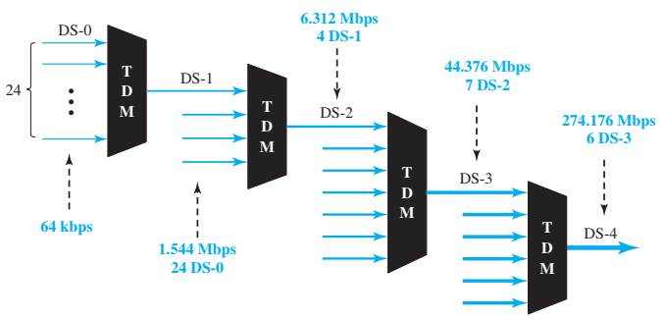
Digital Signal Service
Telephone companies implement TDM through a hierarchy of digital signals, called digital signal (DS) service or digital hierarchy

Slide 37
Digital Signal Service
DS-0 is a single digital channel of 64 kbps.
DS-1 is a 1.544-Mbps service; 1.544 Mbps is 24 times 64 kbps plus 8 kbps of overhead. It can be used as a single service for 1.544-Mbps transmissions, or it can be used to multiplex 24 DS-0 channels.
DS-2 is a 6.312-Mbps service; 6.312 Mbps is 96 times 64 kbps plus 168 kbps of overhead. It can be used as a single service for 6.312-Mbps transmissions; or it can be used to multiplex 4 DS-1 channels, 96 DS-0 channels, or a combination of these service types.
DS-3 is a 44.376-Mbps service; 44.376 Mbps is 672 times 64 kbps plus 1.368 Mbps of overhead. It can be used as a single service for 44.376-Mbps transmissions; or it can be used to multiplex 7 DS-2 channels, 28 DS-1 channels, 672 DS-0 channels, or a combination of these service types.
DS-4 is a 274.176-Mbps service; 274.176 is 4032 times 64 kbps plus 16.128 Mbps of overhead. It can be used to multiplex 6 DS-3 channels, 42 DS-2 channels, 168 DS-1 channels, 4032 DS-0 channels, or a combination of these service types.

Slide 38
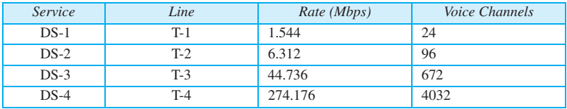
T Lines
DS-0, DS-1, and so on are the names of services. To implement those services, the telephone companies use T lines (T-1 to T-4).

Slide 39
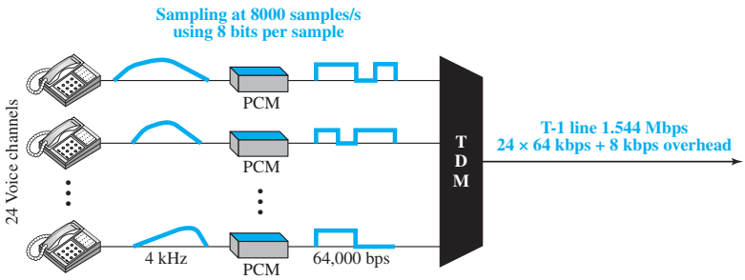
T Lines for Analog Transmission
T lines are digital lines designed for the transmission of digital data, audio, or video.
Analog signals can still be transmitted over T lines provided they are sampled and quantized (PCM).

Slide 40
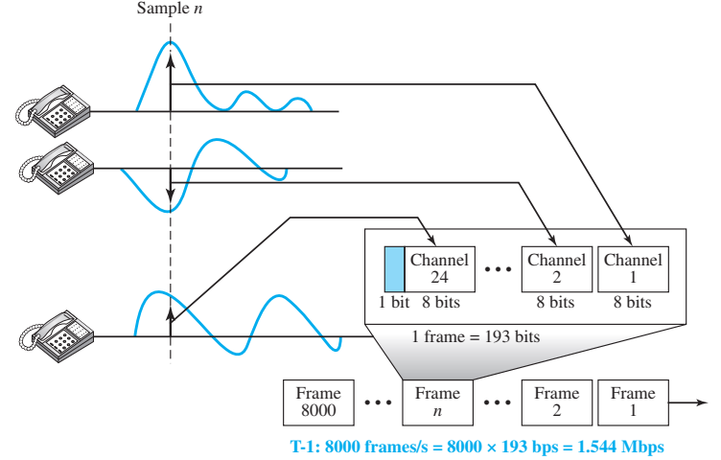
T-1 Frame

Slide 41
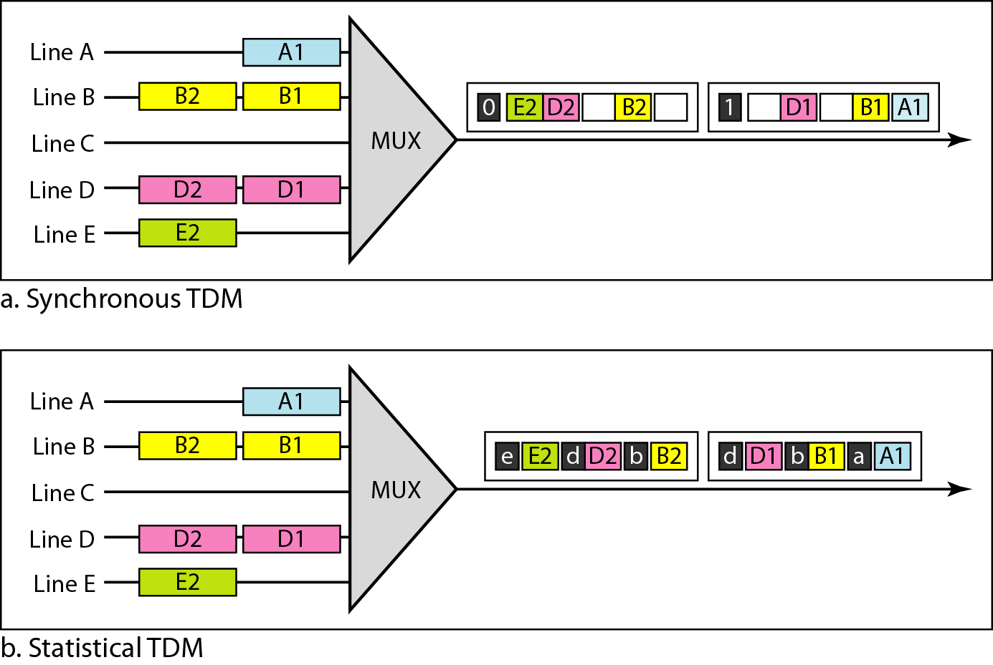
Synchronous TDM vs Statistical TDM

Slide 42
Example TDM
We need to use synchronous TDM and combine 20 digital sources, each of 100 Kbps. Each output slot carries 1 bit from each digital source, but one extra bit is added to each frame for synchronization. Answer the following questions:
a. What is the size of an output frame in bits?
b. What is the output frame rate?
c. What is the duration of an output frame?
d. What is the output data rate?
e. What is the efficiency of the system (ratio of useful bits to the total bits)?

Slide 43
Solution
a. Each output frame carries 1 bit from each source plus one extra bit for synchronization. Frame size = 20 × 1 + 1 = 21 bits.
b. Each frame carries 1 bit from each source. Frame rate = 100,000 frames/s.
c. Frame duration = 1 /(frame rate) = 1 /100,000 = 10 ms.
d. Data rate = (100,000 frames/s) × (21 bits/frame) = 2.1 Mbps
e. In each frame 20 bits out of 21 are useful. Efficiency = 20/21= 95%

Slide 44
Spread Spectrum
Multiplexing combines several sources on one output lines, Spread Spectrum also combines input from multiple source but the goal is somewhat different.
Spread spectrum is designed to be used in wireless applications (LANs and WANs)
In wireless applications, all stations share air as the medium for communication.
For some applications, it is necessary for the system to resist external interferences and to make it difficult for unauthorized receivers to receive the message being transmitted
A communication is called as secure communication where noise interference does not affect signals much and unwanted receivers should not detect the message

Slide 45
Spread Spectrum
To achieve these goals, spread spectrum techniques add redundancy; they spread the original spectrum needed for each station.
If the required bandwidth for each station is B, spread spectrum expands it to B_{ss}, such that B_{ss} >> B.
The expanded bandwidth allows the source to wrap its message in a protective envelope for a more secure transmission.

Slide 46
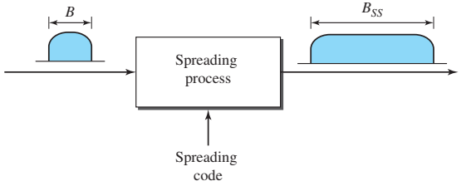
Spread Spectrum
Principles of spreading
  The bandwidth allocated to each station needs to be, by far, larger than what is needed. This allows redundancy.
  The expanding of the original bandwidth B to the bandwidth B_{ss} must be done by a process that is independent of the original signal.

Slide 47
Frequency Hopping Spread Spectrum
The frequency hopping spread spectrum (FHSS) technique uses M different carrier frequencies that are modulated by the source signal.
At one moment, the signal modulates one carrier frequency; at the next moment, the signal modulates another carrier frequency.
Although the modulation is done using one carrier frequency at a time, M frequencies are used in the long run.
The bandwidth occupied by a source after spreading is B_{FHSS} >> B.

Slide 48
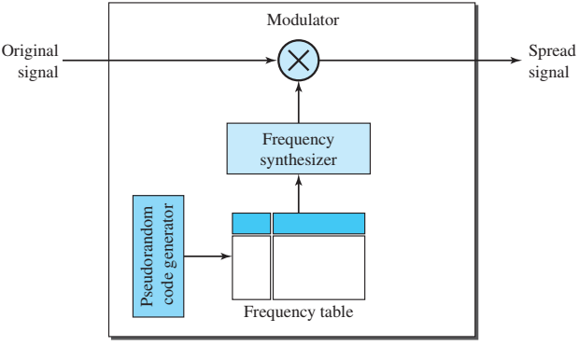
Frequency Hopping Spread Spectrum
A pseudorandom code generator, called pseudorandom noise (PN), creates a k-bit pattern for every hopping period T_{h}.
The frequency table uses the pattern to find the frequency to be used for this hopping period and passes it to the frequency synthesizer.
The frequency synthesizer creates a carrier signal of that frequency, and the source signal modulates the carrier signal

Slide 49
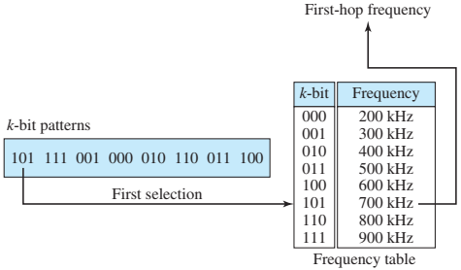
FHSS: Frequency Table
Depending upon the number of hopping frequencies (M), we need k-bit pattern to identify each of these frequencies
The pattern is pseudorandom; it is repeated after M hopping.
At hopping period 1, the pattern is 101. The frequency selected is 700 kHz; the source signal modulates this carrier frequency. The second k-bit pattern selected is 111, which selects the 900-kHz carrier; the eighth pattern is 100, and the frequency is 600 kHz.
After eight hopping, the pattern repeats, starting from 101 again.

Slide 50
FHSS: Security and Reliability
If there are many k-bit patterns and the hopping period (dwell time) is short, a sender and receiver can have privacy.
If an intruder tries to intercept the transmitted signal, she can only access a small piece of data because she does not know the spreading sequence to quickly adapt herself to the next hop.
The scheme also has an antijamming effect. A malicious sender may be able to send noise to jam the signal for one hopping period (randomly), but not for the whole period.

Slide 51
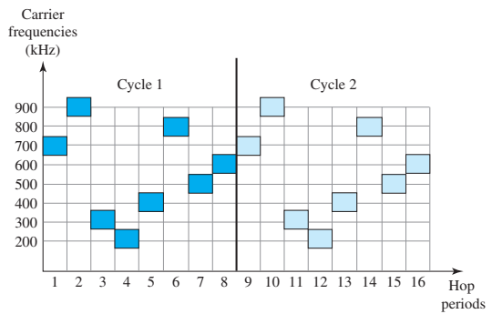
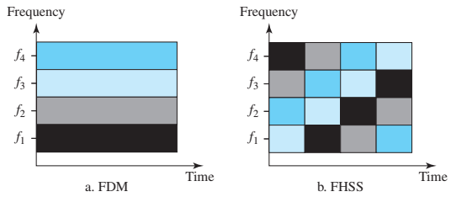
FHSS: Bandwidth Sharing
If the number of hopping frequencies is M, we can multiplex M channels into one by using the same B_{ss} bandwidth. This is possible because a station uses just one frequency in each hopping period; M − 1 other frequencies can be used by M − 1 other stations.
M different stations can use the same B_{ss} if an appropriate modulation technique such as multiple FSK (MFSK) is used. FHSS is similar to FDM

Slide 52
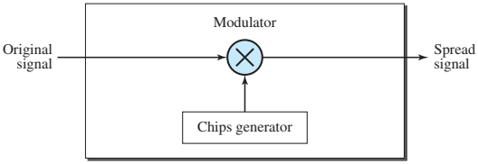
Direct Sequence Spread Spectrum
DSSS technique also expands the bandwidth of the original signal
In DSSS, each data bit is replaced with n bits using a spreading code. In other words, each bit is assigned a code of n bits, called chips, where the chip rate is n times that of the data bit

Slide 53
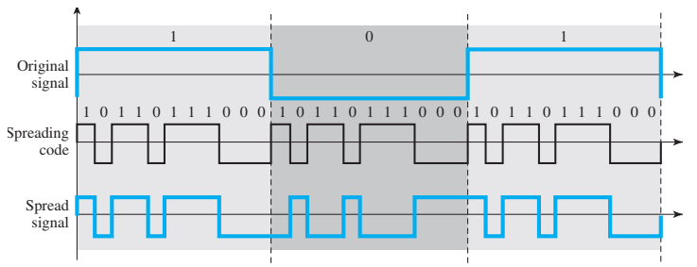
Direct Sequence Spread Spectrum
Wireless LAN (802.11b) uses the famous Barker sequence, where n is 11 (1 0 1 1 0 1 1 1 0 0 0)
If the original signal rate is N, the rate of the spread signal is 11N
The required bandwidth for the spread signal is 11 times larger than the bandwidth of the original signal.
It can provide privacy if the intruder does not know the code. It can also provide immunity against interference if each station uses a different code

Slide 54
DSSS: Bandwidth Sharing
If we use a spreading code that spreads signals (from different stations) that cannot be combined and separated, we cannot share a bandwidth.
All Wireless LAN stations uses the same code for spreading. Bandwidth can not be shared
In Cellular networks (using DSSS), all mobile stations are assigned unique orthogonal codes. Their transmission can be separated with unique code. Bandwidth is shared between all users.

Slide 55
DSSS: Example
Assume two senders A and B using Chipping sequences ([+1, -1, +1, -1] and [+1, +1, -1, -1]). Note both sequences are orthogonal to each other.
A sends binary bit 1 and B sends bit 0
Spread the data
  A: S1=D1×C1=(1)×[+1,−1,+1,−1]=[+1,−1,+1,−1]
  B: S2=D2×C2=(-1)×[+1,+1,−1,−1]=[-1,-1,+1,+1]
Transmit combined signal
  S=S1+S2=[+1,−1,+1,−1]+[-1,-1,+1,+1]=[0,−2,+2,0]
Despread on receiver
  R_{A} : R_{A} = S⋅C1=[0,−2,+2,0]⋅[+1,−1,+1,−1] = 0+2+2+0 = 4 / 4 = +1 (Means 1 was sent)
  R_{B} : R_{B} = S⋅C2=[0,−2,+2,0]⋅[+1, +1, -1, -1] = 0-2-2+0 = -4 / 4 = -1 (Means 0 was sent)

Slide 56
Questions ?
Thanks !!!

